Slide 1
Early signs of ADHD in girls
Una Archer GMBPsS
www.helpyourchildthrive.co.uk
Amherst School
February 6, 2024

Slide 2
Introductions

Slide 3
ADHD statistics
ADHD is estimated to be prevalent in 5.3% of individuals aged 18 or younger, affecting girls and boys about the same rate
Girls are three times less likely to be referred for an assessment or receive an correct diagnosis
Only about 5% of girls with ADHD receive the appropriate support
About 75% of people with ADHD continue experiencing symptoms throughout their lives

Slide 4
Today we’ll cover
ADHD symptoms in girls
ADHD brain vs neurotypical brain
Reasons why ADHD is often overlooked in girls
Impact of unrecognised ADHD
Supporting girls with ADHD traits
Q&A

Slide 5
ADHD a neurodevelopmental condition characterised by persistent symptoms of inattention and/or hyperactivity-impulsivity that interfere with functioning or development

Slide 6
How ADHD shows up in day-to-day life

Slide 7
Home
Attention
Appearing not to listen
Difficulties with multi-step directions
Less likely to start or complete a task
Impulsivity / Hyperactivity
Extreme prolonged emotional responses
Interrupting conversations
Not accounting for consequences

Slide 8
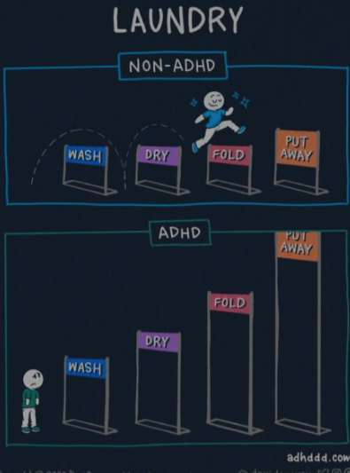

Slide 9
School
Attention
Making “careless” mistakes
Difficult to get organised
Time blindness: starting tasks last minute, spending excessive time completing tasks r
Impulsivity / Hyperactivity
Giving into distractions
Difficulties while waiting
Restlessness fidgeting

Slide 10
Friends
Attention
Extreme focus on what interests them
Difficult to listen to what other person is saying
Getting bored and moving between activities, friendship groups
Impulsivity / Hyperactivity
Impulsive reactions, difficulty to slow down to process their feelings
Rejection sensitivity
Could be more likely to engage in risky behaviours

Slide 11
Reasons why ADHD is often overlooked in girls
It is a broad spectrum, full of contradictions
ADHD symptoms in girls are often thought of as personality characteristics or immaturity
Masking strategies (and scaffolding)
Internalized symptoms
Girls with ADHD are more likely to also have mental health conditions that involve internalizing symptoms, like anxiety and depression

Slide 12
Assessment
Based on observation
Based on neurofunctional data

Slide 13
Differences in the brain

Slide 14
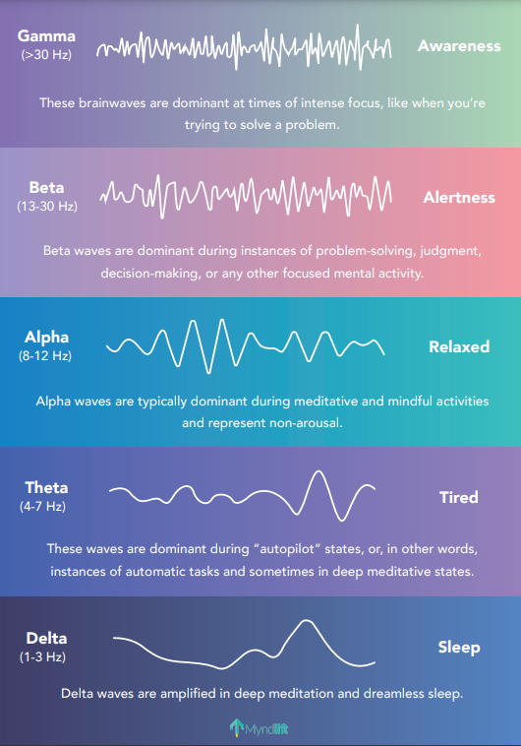

Slide 15
Brain patterns of somebody with ADHD symptoms often show:
Too much slow wave activity
Too much fast wave activity

Slide 16
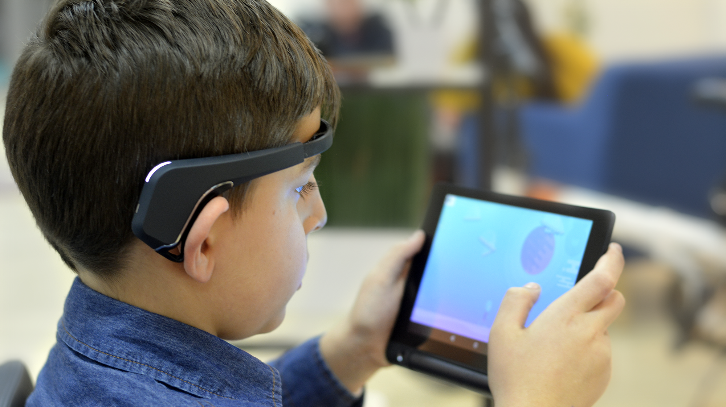
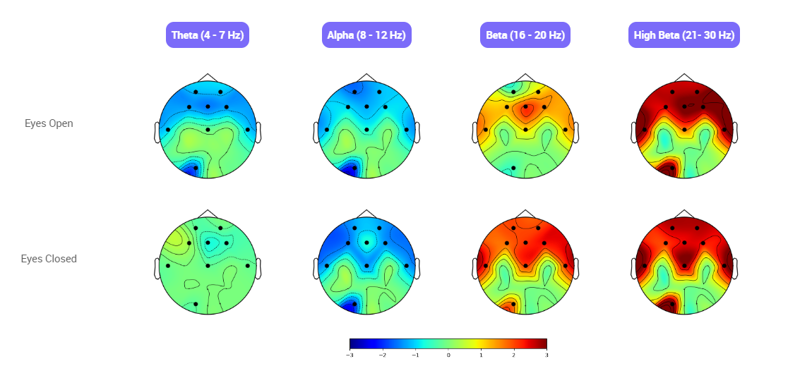

Slide 17
ADHD is not a personality trait, it is a neurodevelopmental condition

Slide 18
Lack of support for girls with ADHD can result in:
Internalising their symptoms, feeling ashamed about who they are
Mental health difficulties well into adulthood: higher levels of anxiety, depression, sleep difficulties, substance misuse and eating disorders
Social isolation
Twice the risk of teenage pregnancy
Adulthood: poorer general health, higher rate of divorce, lower income, alcohol use disorders
Notes:
Luderer M et al. Alcohol use disorders and ADHD. Neuroscience and Biobehavioral Reviews 2021; 128: 648–660.

Slide 19
ADHD support

Slide 20
Specialist ADHD support:
Psychoeducation
Coaching / counselling
Neurofeedback training
Medication
Notes:
Luderer M et al. Alcohol use disorders and ADHD. Neuroscience and Biobehavioral Reviews 2021; 128: 648–660.

Slide 21
3 pillars for brain health:
Sleep: 7-9 hours
Nutrition: good fats and leafy greens
Exercise: 30 minutes at least 3 times a week
Notes:
Luderer M et al. Alcohol use disorders and ADHD. Neuroscience and Biobehavioral Reviews 2021; 128: 648–660.

Slide 22
We live in a society that is less kind to neurodiverse people than to neurotypical people
Notes:
Statistic of 20 000 negative comments

Slide 23
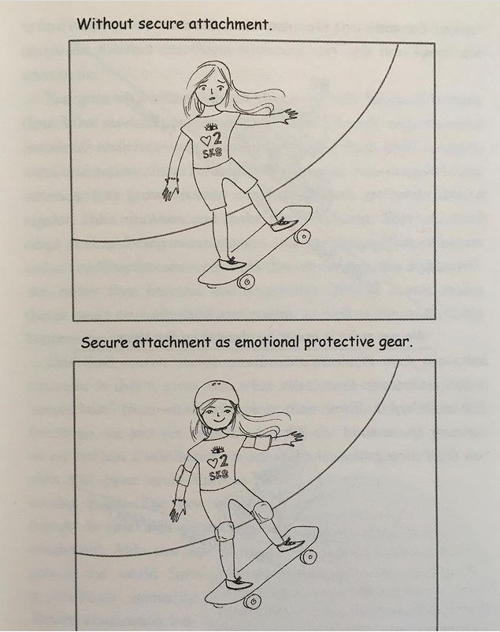
Creating a secure base at home
Adjusting expectations
Replacing frustration with curiosity (late example)
Asking open questions
Circle of Security Parenting course
Notes:
Luderer M et al. Alcohol use disorders and ADHD. Neuroscience and Biobehavioral Reviews 2021; 128: 648–660.

Slide 24

Notes:
I want to help parents raise children who have a strong sense of self-worth and, overall, feel good about themselves

Slide 25
ADHD management does determine whether it is more of a blessing or a curse.
Hallowell and Ratey (2021)

Slide 26
For further support visit
www.helpyourchildthrive.co.uk

Slide 27
Feedback forms and Q&A

