Slide 1
Welcome to Year 5
Year 5 Teachers
Mrs Archer – 5A
Miss Jones – 5J
Mrs Carver & Mrs Siddorns – 5CS
Notes:
AA

Slide 2


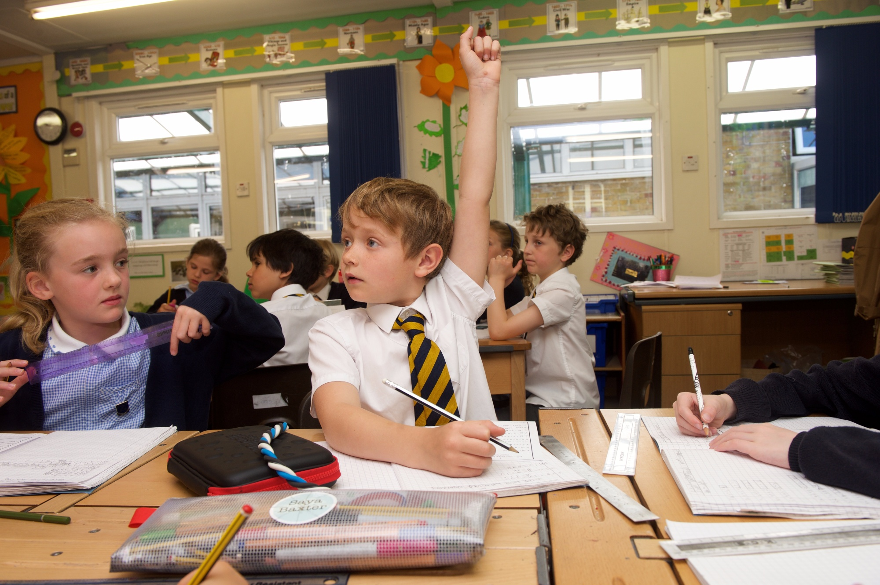
Amherst Values
TRUST
KINDNESS
POLITENESS
FAIRNESS
DETERMINATION
CO-OPERATION
Notes:
TJ

Slide 3
Whole School Focus
‘Inspire Every Pupil’
Build teamwork, Caring ethos, communication, respect within classes
Continuing Circle Time
Improving the learning environment-classrooms/playground
Embedding reading comprehension skills
Reinforce school values and behaviour curriculum
Explicitly teaching and modelling behaviours we wish to see e.g. table manners, not answering back, following instructions from the adults, appropriate language (not discriminatory), holding doors open for others, wearing correct school uniform and PE kit
Notes:
TJ

Slide 4
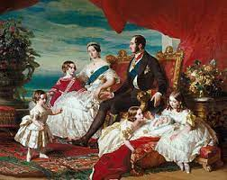
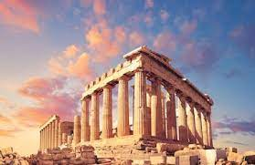
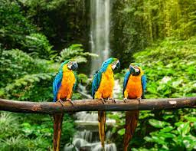

Year 5
Notes:
SC

Slide 5

Now is the time for your child to develop more independence.
Homework
Planners
P.E Kit
Notes:
TJ

Slide 6
Homework
Out on Thursdays, in on Tuesdays.
We also understand that the jump up from Year 4 to Year 5 is hard work, especially having to complete MA, English and spellings each week.
You know your child the best – please ask them to try to work independently for a minimum of 20 minutes per subject.
If you are finding the set work is taking too long please let your class teacher know, draw a line and stop.
Please make us aware where you have helped your child (e.g. star a question in MA).
Notes:
TJ

Slide 7
MA Homework
One page a week.
First test done in class (30 minutes), so should be the right page.
Some may have moved sections/books.
30 minutes for one page. Up to you how this is allocated.
Please try independently first.
Star questions they have help with.
Approx. 3-6 questions wrong per page.
Encourage corrections first.
Working out paper – encourage.
Notes:
TJ

Slide 8
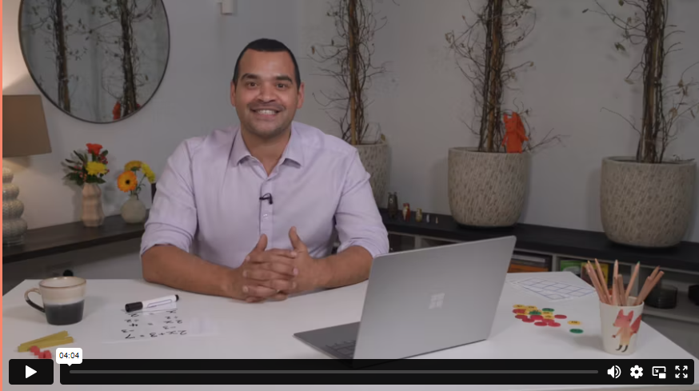
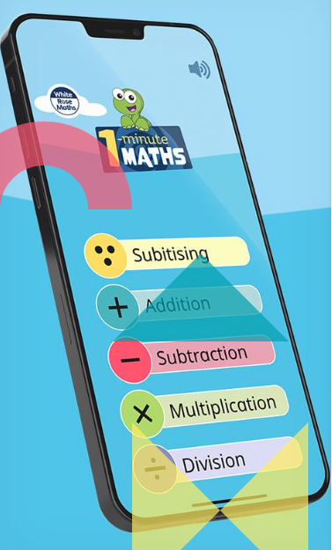
How can I help my child with maths?
At Amherst, we follow the White Rose Maths scheme.
Maths with Michael: Video resources for parents explaining teaching methods.
1 minute maths: App for improving number confidence and fluency.
Ask! We are happy to go through any MA questions with children at school.
Times Tables Rockstars
Notes:
SC

Slide 9
Homework
We understand that in Year 5, the Kent Test, for some of you, is prevalent in your mind.
However, to avoid unnecessary stress for your child, please can you ensure that school work is a priority over and above any set by a tutor.
Don’t let your child become overloaded – happy child = happy teacher = happy parents!
Notes:
AA

Slide 10
Spelling homework
10 spelling words will be tested each week.
The spelling words will come from:
  The spelling rule taught in class that week in our spelling lesson.
  The Year 5/6 ‘statutory word list’.
Evidence of this should be dated and recorded in back of the red literacy homework books.
Notes:
AA

Slide 11
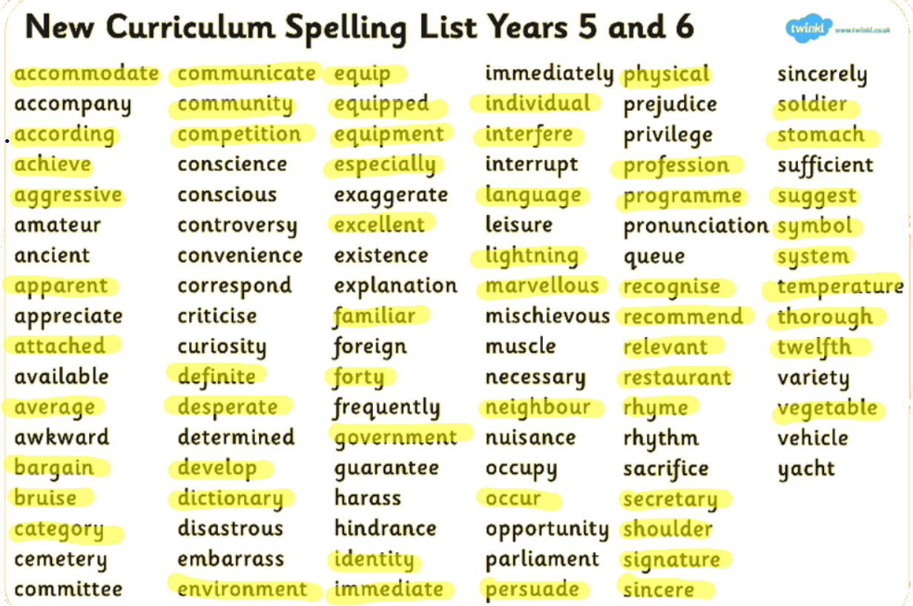
Y5/6 Statutory Spellings
Notes:
AA

Slide 12
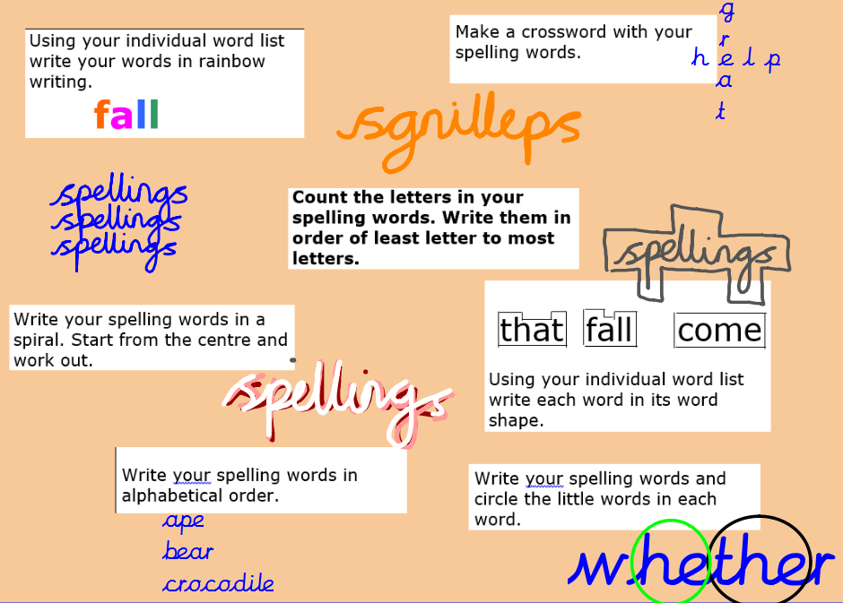
Notes:
AA

Slide 13
Planners
When to bring in?
What are they used for?
What to write?
Which books to read?
How to support at home:
It is most effective for children to experience a mixture of reading independently, reading aloud with an adult and listening to an adult or an audiobook.
Please also monitor your child’s comprehension by chatting to them about what they’ve been reading.
Notes:
TS

Slide 14

Advantages of reading regularly
Notes:
TS

Slide 15
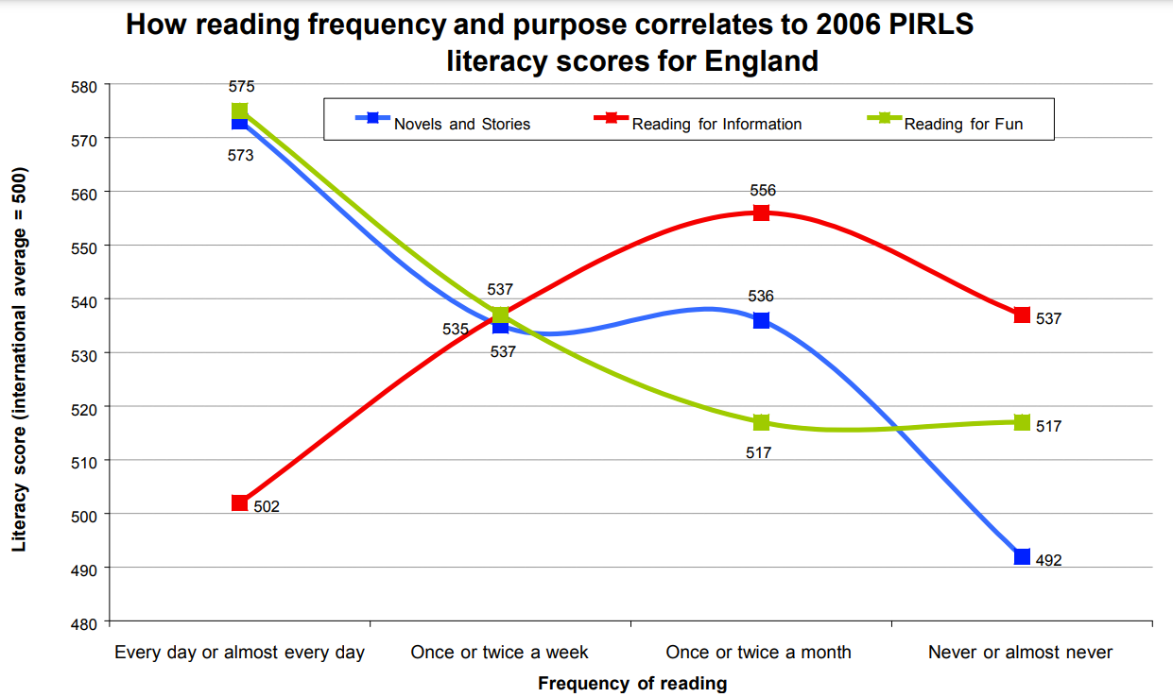
The Importance of Reading for Pleasure
“The key finding is that frequent reading for pleasure is correlated to higher PIRLS literacy scores. However, reading for information is much less well correlated.” (DfE, 2012)
Notes:
TJ

Slide 16


https://www.booksfortopics.com/branching-out
https://www.thereaderteacher.com/bookmatch
Notes:
AA

Slide 17

Parent Readers
Wednesday afternoons
Notes:
AA

Slide 18
PE and Games
Year 5 games is on a Thursday this term. It may change each term. We will keep you informed.
This half term we are alternating between tag rugby and hockey. (no gum shield=no hockey!)
Year 5 PE is on a Monday this term. We will let you know if this changes.
We are all partaking in gymnastics.
Please send your child in with a full kit on a Monday for that week. Please name the items!
Notes:
SC

Slide 19
PE Kit
Gumshield and shinpads required for hockey.
No gumshield = no hockey.
Please speak to your class teacher if struggling to source this.
Children should have their PE kit in school every day.
Amherst or plain navy t-shirt, shorts, different socks, and trainers.
Optional: Navy blue school sweatshirt/Team Amherst hoodie and navy blue jogging trousers for cold weather.
All school kit is available to buy through the office.
Notes:
SC

Slide 20
Educational Visits/Activities
We are very excited to have booked in visits and activities. Trips have become very expensive in recent years, so we have tried to create a balanced mix of in-school and out-of-school experiences.
Science roadshow at school - 30th September
Victorian Day at school (costume needed) date TBC
Pantomime at school - 1st December
Future trips include: Rainforest animals workshop, Mr Dilly Greek Show, Greek Day at School (costume needed).
Notes:
TJ

Slide 21
Dates for the Diary
2nd October – School Photographs
16th October – Term Ends
17th October – Inset Day
28th October – Term Begins
14th November – Open Afternoon 2:45pm
25th & 27th November – Parents’ Evening
28th November – Clubs end
1st December – Christmas pantomime in school
6th December – Christmas bazaar
15th December – Carol concert
18th December – Christmas Lunch
19th December – End of Term
Notes:
TS

Slide 22
Transition to Secondary
You will be beginning to consider which secondary school your child might attend.
Whether your child will be taking the Kent Test or not next September, this is an important academic year for all of them.
Make sure you and your child look around a variety of secondary schools this year, both in and out of school hours.
Be mindful how many days your child is out of school, especially in the Summer Term. If your child misses a lesson, they’ll miss key parts of the curriculum.
There will be a separate Year 5 Parent Consultation in June to help you make an informed choice as to which school best suits your child.
Notes:
AA

Slide 23
Positive Routines
Screen-free bedtime routine which includes a story.
Unstructured free play.
“Cultural capital”: going to museums, libraries, dinner-time conversation about the world, etc.
Participation in the arts (e.g. dance, drama, music).
Notes:
SC

Slide 24
Miscellaneous
Music lessons
  Children should only have one lesson during curriculum time, in the afternoon.
  If your child is away or on a school trip, it is your responsibility to inform their music teacher.
Clubs
  Your child should inform the person running the club if they are going to be absent or no longer wish to participate.
  We encourage every child to attend at least one club.
Notes:
SC

Slide 25
Miscellaneous
Parent-Teacher Communication
  For quick questions/issues, please feel free to chat to the class teacher at the gate.
  Meetings should be arranged via the school office.
School Website
  Please look regularly at the school website and read the school newsletters for all updates and information.
Notes:
SC

Slide 26
After this meeting
Once we have finished in the hall, there is the opportunity to visit your child’s classroom.
If you are ready to leave even after five minutes, please don’t feel pressure to stay!
We have individual Parent Consultations in November to discuss your child’s academic progress.
Notes:
TS

