Slide 1
Year 5
Kent Test and Hilltop Information Session
Tuesday 19th May 2026
6.00pm

Slide 2
How do I register my child for the Kent Test?
Online at www.kent.gov.uk/ola
You can register on paper by contacting the KCC Secondary Admissions Team on
03000 41 21 21

Slide 3
You must register your child between Monday 1st June and Wednesday 1st July 2026.
Who can take the Kent Test
Children currently in Year 5 who were born between 1 September 2015 and 31 August 2016 can take the Kent Test in 2026.
If your child is outside this age range but is expected to transfer to secondary school in September 2026, email kent.admissions@kent.gov.uk.

Slide 4
Key Dates
Registration opens | Monday 1st June 2026
Closing date to register for tests | Wednesday 1st July 2026
Children sit the Kent Test | Thursday 10th September 2026
Kent Test results emailed / posted to parents | Thursday 15th October 2026
National SCAF closing date | Monday 2nd November 2026
National Offer Day | Monday 1st March 2027

Slide 5
Kent Test
Test Format
The tests are multiple-choice with a separate answer sheet. They are marked by a computer.
The first test will be an English and maths paper and will take 1 hour. Each section will involve a 5 minute practice exercise followed by a 25 minute test. The English section will involve a comprehension exercise as well as some additional questions drawn from a set designed to test literacy skills.
The second test will be a reasoning paper. It will take about 1 hour, including the practice sections and questions. It will contain a verbal reasoning section and a non-verbal reasoning section of roughly the same length. The non-verbal reasoning will be split into short sections, administered and timed individually.
There will also be a writing exercise which will not be marked but may be used by a local headteacher panel as part of the headteacher assessment stage of the process. 40 minutes will be allowed for the writing task, including 10 minutes planning time.

Slide 6
Kent Test
In 2025 the pass mark was:
An aggregated score of 332 or more, with no single score lower than 108.
Scores in this year’s standardisation ran from 69 to 141.
423 was therefore the maximum score any pupil could achieve.
NFER Scores (the scores on your child’s end of year school report) are based on 116 – 141 being the approx. standard for the Kent Test.
New entrance test for Weald Grammar from Sept 2026.

Slide 7
Test Information
There is much useful information on the following websites:
www.kent.gov.uk/education-and-children/schools/school-places/kent-test
https://11plus.gl-assessment.co.uk/free-materials/

Slide 8
We will complete a verbal and non-verbal reasoning paper in June. This will be for all children. We will complete a writing task in Week 1 or 2 of September in the hall to replicate exam conditions. We return to school, after the summer holidays, on Thursday 3rd September.
We will complete NFER tests in English (reading comprehension) and Maths in June. The standardised scores and discussion with your child’s teacher, will help inform your decision on whether to enter the test.
We have an equal balance of English and Maths teaching which should prepare the children well for each test. We are aware of any gaps in the Year 5 summer term maths National Curriculum and these have been integrated into our curriculum.

Slide 9
Parental Support
Year 5 Parents’ Evening 16th and 18th June 2026, face to face in school.
Opportunity to discuss your child’s current attainment and recent test scores in relation to entering the Kent Test.
It is a parental decision to enter for the Kent Test not the school’s.
We hope to be able to support you so that you can make an informed choice.
To decide on possible secondary schools, you must visit them with your child. We encourage these visits.

Slide 10
Access Arrangements
If you believe your child could be eligible for access arrangements such as extra time please contact our SENCO Misss Watson:
senco@amherst.kent.sch.uk
She will have a discussion with you and decide if an application is appropriate. Having a diagnosis or a report stating a child is eligible for extra time is not a guarantee they will get it.

Slide 11
If your child was not successfully grammar school assessed, the grammar school will turn down your application, and you'll be offered a different school. You have the right to appeal (if you name a grammar school as one of your four preferences) to explain why you think grammar school is a suitable option for your child. You can not go on the waiting list for a grammar school if you child didn’t pass the test.

Slide 12
School | Amherst Pupils Offered Sept 2026
Bennett Memorial | 3
Hillview | 3
The Judd School (Entry score 385) | 10
Knole Academy | 17
St. Gregory’s School | 0
Leigh Academy | 6
St. Olave’s Grammar School | 1
Hadlow College | 0
The Skinners’ School (Entry Score 372, sibling link then distance) | 3
Tonbridge Girls Grammar (Entry Score 377) | 9
T Wells Boys Grammar | 16
T Wells Girls Grammar | 1
Weald of Kent Girls Grammar | 15
The Trinity School | 8
Independent Schools
58% (56 pupils) of all Year 6 pupils passed the Kent Test in 2025. 80 pupils sat the test.

Slide 13
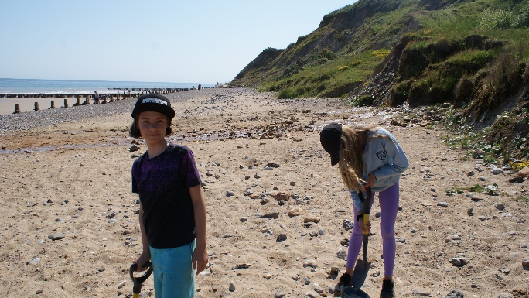

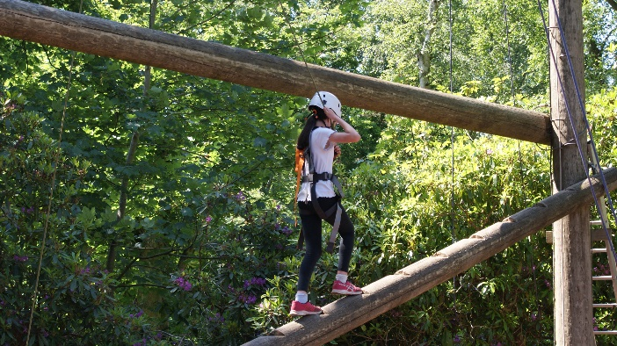
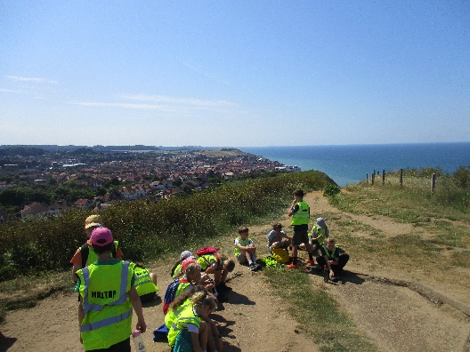
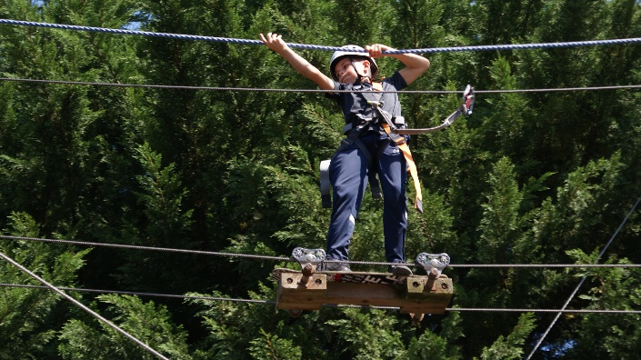
Hilltop
2027
Now for something lighter!
Monday 8th June –
Friday 12th June 2026

Slide 14
Cost will be approx. £620. This can be paid in six instalments: July, Sept, Nov, Jan, March and April.
If you have any concerns over payment please speak to Mr Reid.

Slide 15
https://www.hilltopoutdoorcentre.co.uk/hilltop-video

