Slide 1
Welcome to Year 5
Year 5 Teachers
Mr Taylor – Beech
Miss Jones& Miss Huntley – Rowan
Mrs Carver & Mrs Siddorns – Willow
Notes:
TJ

Slide 2
Whole School Focus
‘Inspire Every Pupil’
Improving the learning environment classrooms/playground, desks, chairs
Active learning- meta cognition, resilience when facing a challenge, use of manipulatives in maths,
Continuing Circle Time
Embedding reading comprehension skills
Handwriting grip and style
Notes:
TJ

Slide 3
Whole school changes
Stationery equipment provided by school (own ink pens are helpful- pen license)
Wearing PE kit to school but please be aware they need football boots/ gum shields/coats as we will still aim to do PE whatever the weather!
No toys/ fiddle toys – please support us with this
Consent for walking home
Classroom names!
Notes:
TJ

Slide 4

Now is the time for your child to develop more independence.
Homework-start on their own
Planners- record for themselves
P.E Kit/ football boots/shin pads
Notes:
TJ

Slide 5
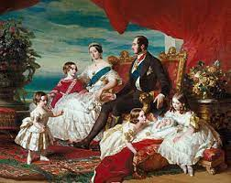
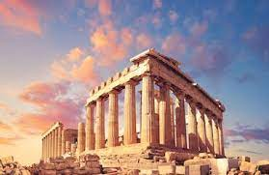
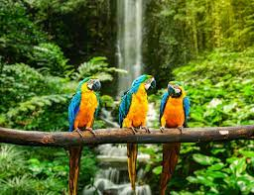

Year 5 topics
Notes:
TJ

Slide 6
Homework
We understand that in Year 5, the Kent Test, for some of you, is prevalent in your mind.
However, to avoid unnecessary stress for your child, please can you ensure that school work is a priority over and above any set by a tutor.
Don’t let your child become overloaded – happy child = happy teacher = happy parents!
Notes:
TJ

Slide 7
Homework
Out on Thursdays, in on Tuesdays.
We also understand that the jump up from Year 4 to Year 5 is hard work, especially having to complete MA, English and spellings each week.
You know your child the best – please ask them to try to work independently for a minimum of 20 minutes per subject.
If you are finding the set work is taking too long, please let your class teacher know, draw a line and stop.
Please make us aware where you have helped your child (e.g. star a question in MA).
Write a note in the planners
Notes:
TJ

Slide 8
MA Homework
One page a week.
First test done in class (30 minutes), so should be the right page.
Some may have moved sections/books.
30 minutes for one page. Up to you how this is allocated.
Please try independently first.
Star questions they have help with.
Approx. 3-6 questions wrong per page.
Encourage corrections first.
Working out paper – encourage.
Cover MA books if possible, to protect them
Notes:
TS

Slide 9
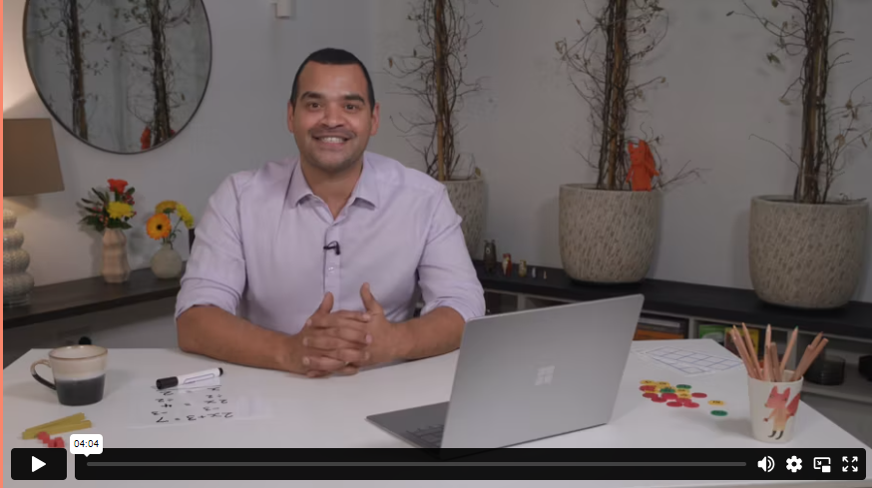
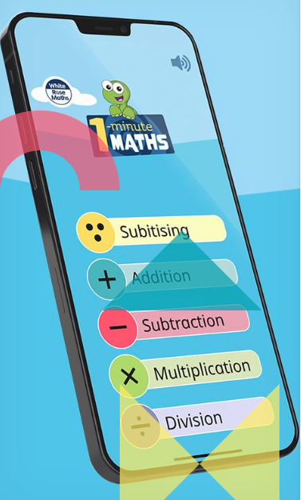
How can I help my child with maths?
At Amherst, we follow the White Rose Maths scheme.
Maths with Michael: Video resources for parents explaining teaching methods.
1 minute maths: App for improving number confidence and fluency.
Ask! We are happy to go through any MA questions with children at school.
Times Tables Rockstars- 5mins/ using garage/ no shop/
Fluency with number bonds
Games- dice/ cards
Telling the time
Notes:
TS

Slide 10
Spelling homework
10 spelling words will be tested each week.
SWT done first to provide a spelling age
The spelling words will come from:
  The spelling rule taught in class that week in our spelling lesson.
  The Year 5/6 ‘statutory word list’.
Evidence of this should be dated and recorded in the red literacy homework books
Some children may have alternative spellings
Notes:
TS

Slide 11
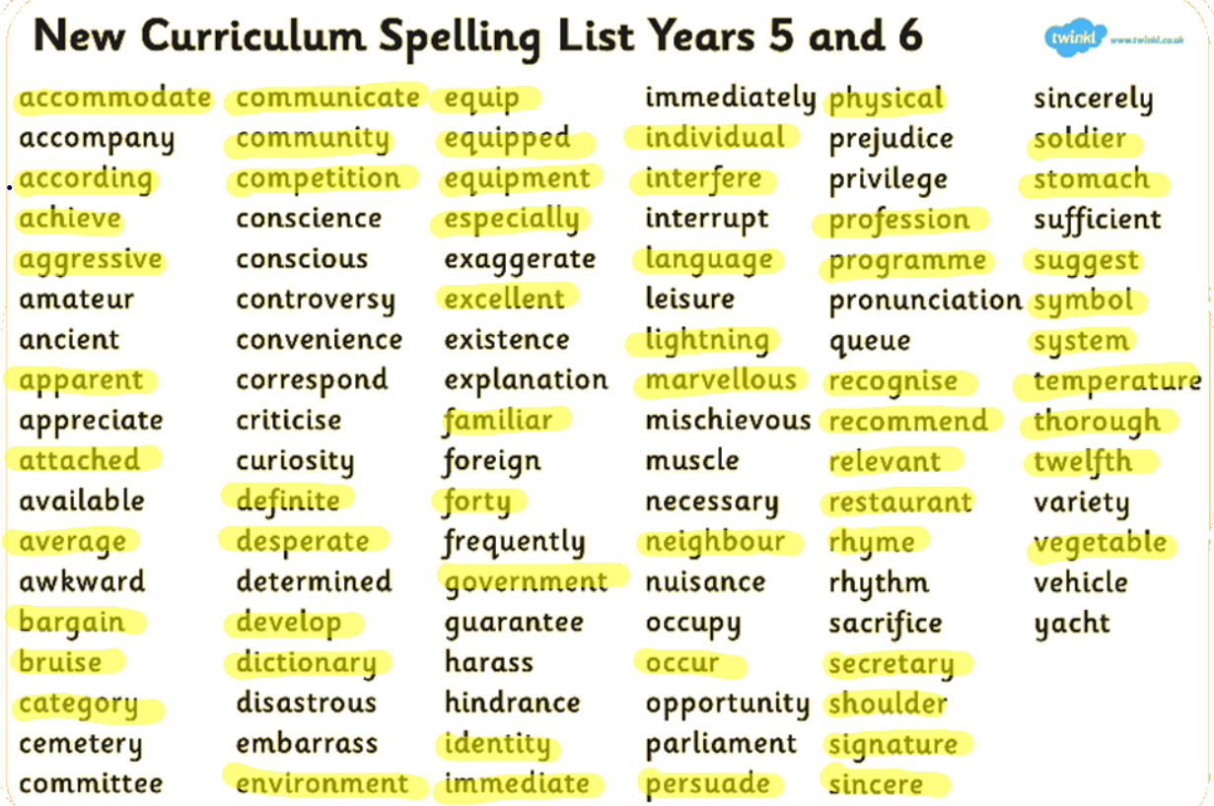
Y5/6 Statutory Spellings
Notes:
TS

Slide 12
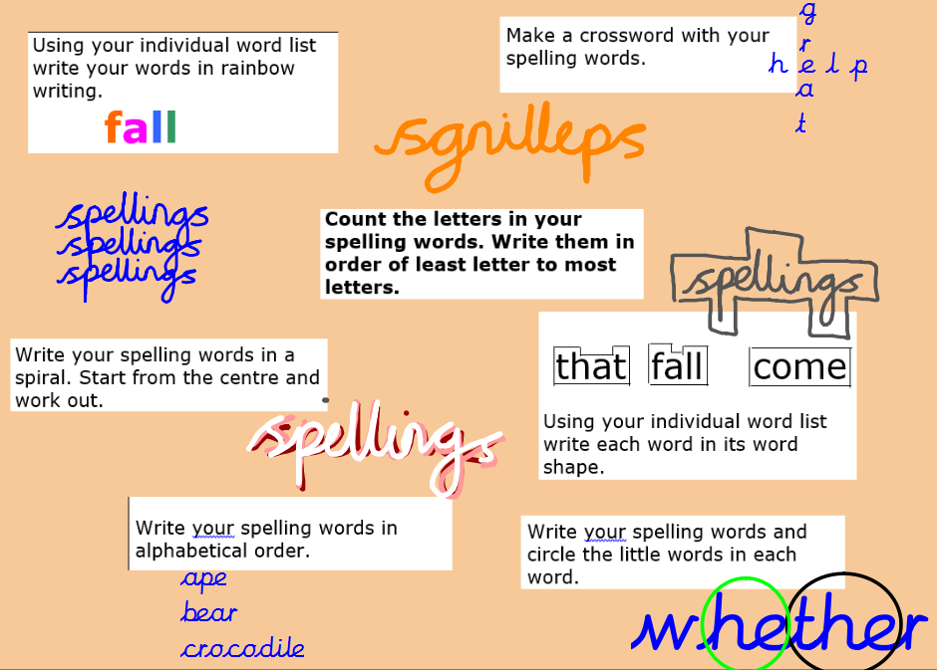
Notes:
TS

Slide 13


https://www.booksfortopics.com/branching-out
https://www.thereaderteacher.com/bookmatch
Notes:
TS

Slide 14

Parent Readers
Wednesday afternoons
Notes:
TS

Slide 15
Planners
Bring in everyday
Children can write in them
Useful subject resources at the back can help with homework e.g. metric measures
Collected on Fridays to check reading
Record the reading
Things to do at Amherst activities at the back
Sign the homeschool agreement
Notes:
JT

Slide 16
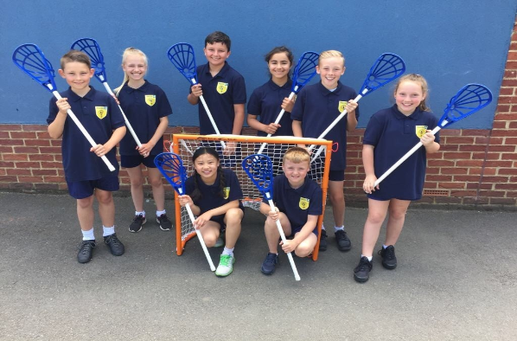
Clubs
Proud of our offer across the school
Enrichment for children outside of the classroom
Encourage them to join at least one to make new friends across all three classes and school
Before, during and after school
Particularly important new joiners to Amherst
Helps to provide some down time from study
Notes:
JT

Slide 17
PE and Games
Year 5 games is on a Thursday this term. It may change each term. We will keep you informed.
This half term we are alternating between tag rugby and hockey. (no gum shield= no match )
Year 5 PE is on a Monday this term. We will let you know if this changes.
We are all partaking in gymnastics (shorts for this and bare feet)
Tracksuit trousers as it gets colder
Swimming Terms 5&6 (very successful last year)
All school kit is available to buy through the office.
Please name the items!
Notes:
JT

Slide 18
Educational Visits/Activities Term 1&2
We are very excited to have booked in visits and activities. Trips have become very expensive in recent years, so we have tried to create a balanced mix of in-school and out-of-school experiences.
Science Dome at school – 21st October
Victorian Day at school (costume needed) date TBC
Pantomime at school – 2nd December
Future trips include: Rainforest animals workshop, Mr Dilly Greek Show, Greek Day at School (costume needed).
Notes:
MH

Slide 19
The Victorians
Welcome any resources to support with lessons
Artefacts lesson in 2 weeks
Eg family pictures, coins, artefacts
Notes:
MH

Slide 20
Dates for the Diary
6th October – School Photographs
22nd October – Term Ends
23rd October – Inset Day
2nd November –Inset day
13th November – Open Afternoon 2:45pm
24th & 26th November – Parents’ Evening
1st December – Christmas pantomime in school
^{5th} December – Christmas bazaar
14th December – Carol concert
16th December – Christmas Lunch
18th December – End of Term
Notes:
MH

Slide 21
Transition to Secondary
You will be beginning to consider which secondary school your child might attend.
Whether your child will be taking the Kent Test or not next September, this is an important academic year for all of them.
Make sure you and your child look around a variety of secondary schools this year, both in and out of school hours.
Be mindful how many days your child is out of school, especially in the Summer Term. If your child misses a lesson, they’ll miss key parts of the curriculum.
There will be a separate Year 5 Parent Consultation in June to help you make an informed choice as to which school best suits your child.
Notes:
MH

Slide 22
Miscellaneous
Music lessons
  Children should only have one lesson during curriculum time, in the afternoon.
  If your child is away or on a school trip, it is your responsibility to inform their music teacher.
Clubs
  Your child should inform the person running the club if they are going to be absent or no longer wish to participate.
  We encourage every child to attend at least one club.
Notes:
TJ

Slide 23
Miscellaneous
Parent-Teacher Communication
  For quick questions/issues, please feel free to chat to the class teacher at the gate.
  Meetings should be arranged via the school office.
School Website
  Please look regularly at the school website and read the school newsletters for all updates and information.
Notes:
TJ

Slide 24
After this meeting
Once we have finished in the hall, there is the opportunity to visit your child’s classroom.
If you are ready to leave even after five minutes, please don’t feel pressure to stay!
We have individual Parent Consultations in November to discuss your child’s academic progress.
Notes:
TJ

