Slide 1
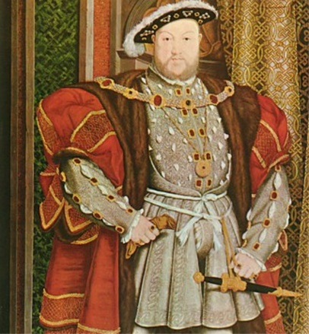
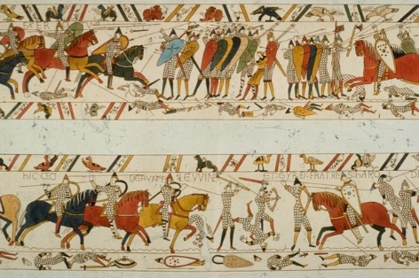

Welcome to Year 4
Mr Hafford-Robson (H-R) – Maple
Mrs Lester & Mrs Stafford – Cedar
Miss Holthausen – Birch
Notes:
Sam

Slide 2
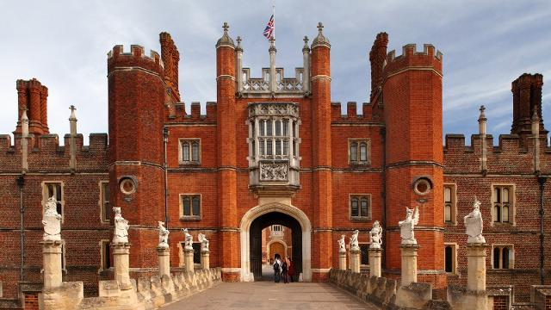
Booked Educational Visits
Anglo-Saxon/Beowulf Workshop
Hampton Court
Pantomime (in school)
More to follow
Notes:
Sam

Slide 3
Homework
Out Thursday/Friday
Handed in by Wednesday
Lexia
MA Books
Reading
Spellings
Notes:
Georgette

Slide 4
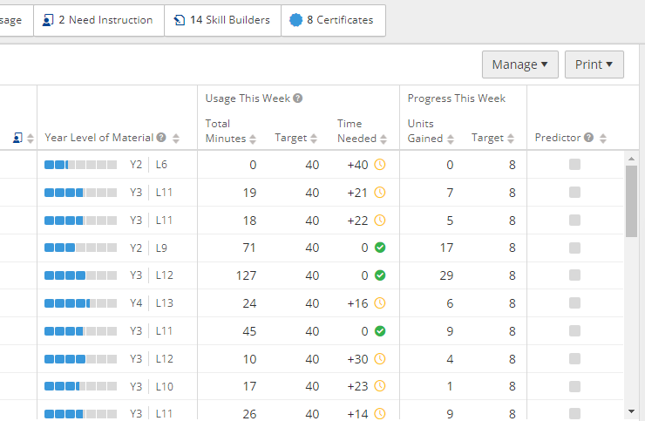
1. Lexia
www.lexiacore5.com
OR
Lexia Core5 Reading iPad app
“…findings indicate that at the end of Year 2, children who received the Lexia programme excelled in reading and made one month of additional progress in comparison with their peers in the control group.” (EEF, 2022)
Notes:
Georgette

Slide 5
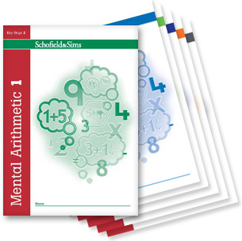
2. MA Books
One page, 30 minutes
Please complete corrections from the previous week
Independence vs. parent support (show with *)
We will try our best to help the children with tricky questions one-to-one in class
Notes:
Lisa

Slide 6

Times Tables
Times Tables Rock Stars
Weekly differentiated times tables tests
Teachers reassess appropriate level through the year
Children encouraged to ‘compete’ against themselves
Children have the option to take their tests home
(The government’s Year 4 Multiplication Tables Check will take place in the Summer Term, testing all up to 12 x 12.)
Notes:
Sam H-R

Slide 7
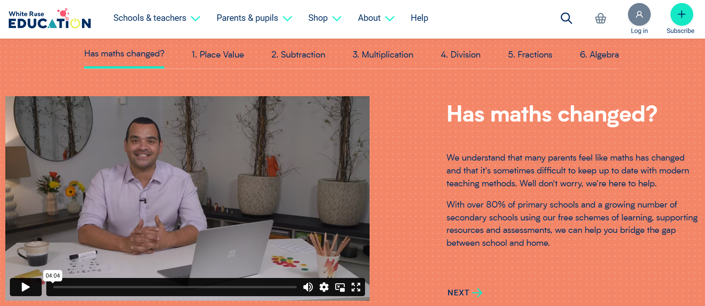
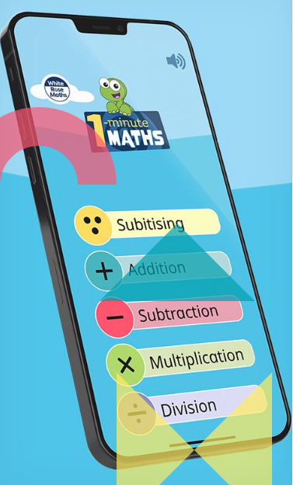
How can I help my child with maths?
At Amherst, we follow the White Rose Maths scheme.
Maths with Michael: Video resources for parents explaining modern teaching methods!
1 minute maths: App for improving number confidence and fluency.
Ask! We are happy to go through any MA questions with children at school.
Notes:
Sam H-R

Slide 8
3. Reading
Planners in on Fridays
What to write?
Which books to read?
How to support at home:
It is most effective for children to experience a mixture of reading independently, reading aloud with an adult and listening to an adult or an audiobook.
Please also monitor your child’s comprehension by chatting to them about their what they’ve been reading.
Parent Readers
Notes:
Georgette

Slide 9
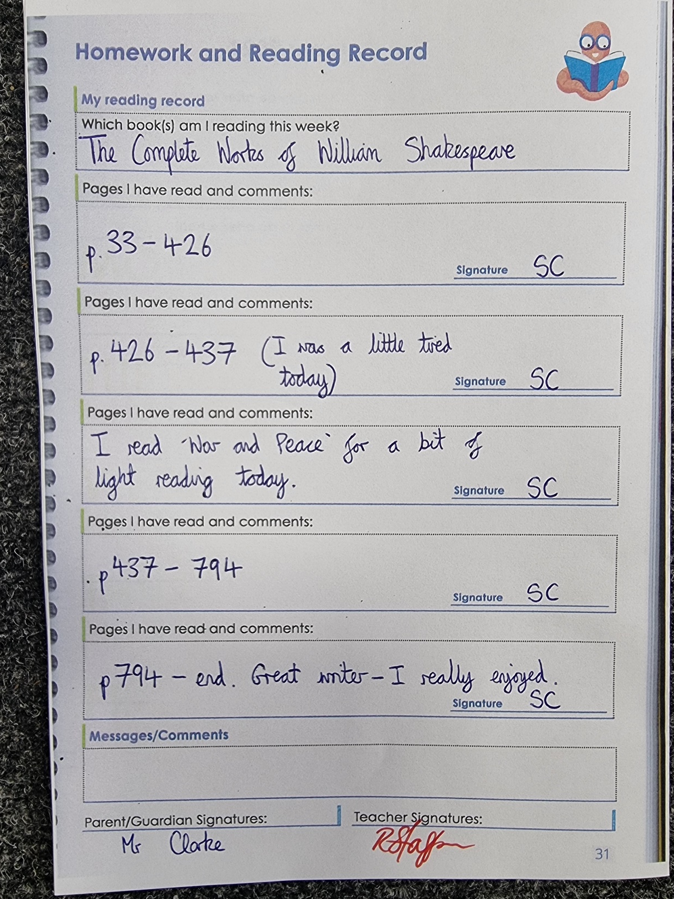
Example of a
completed Planner!
Notes:
Georgette

Slide 10
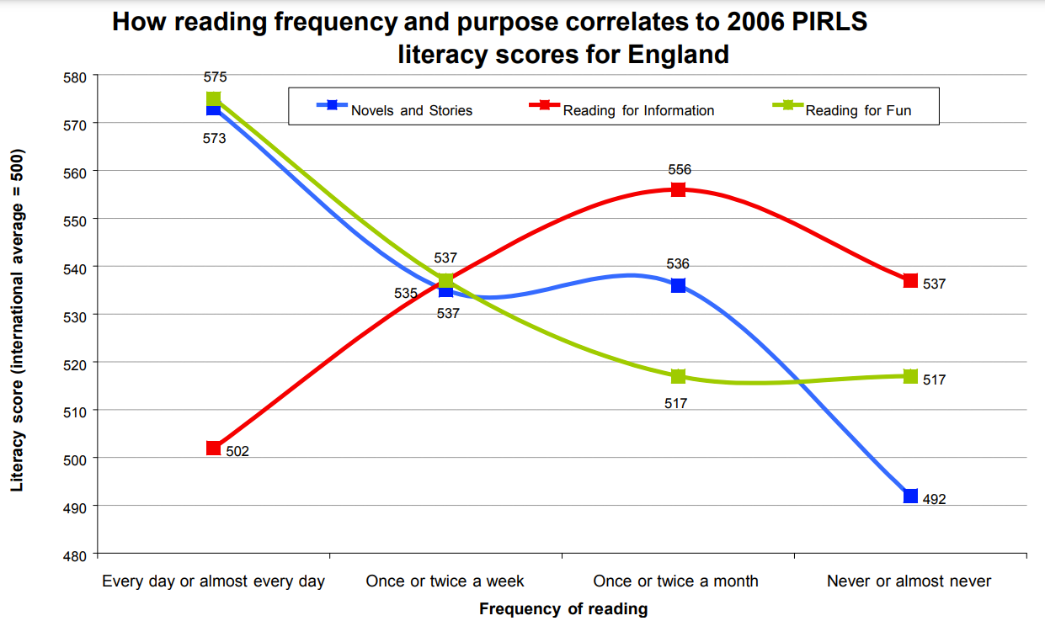
The Importance of Reading for Pleasure
“The key finding is that frequent reading for pleasure is correlated to higher PIRLS literacy scores. However, reading for information is much less well correlated.” (DfE, 2012)
Notes:
Lisa

Slide 11


https://www.booksfortopics.com/branching-out
https://www.thereaderteacher.com/bookmatch
Notes:
Lisa

Slide 12
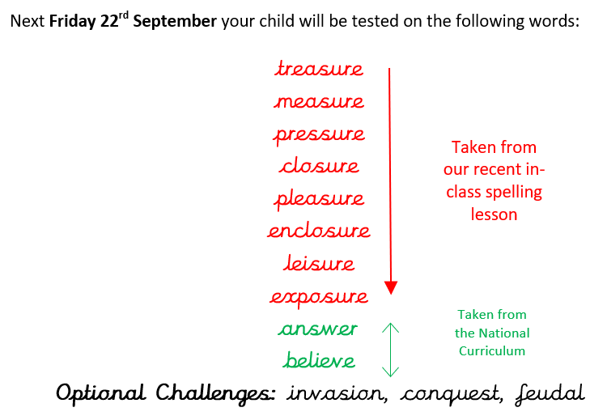
4. Spelling Tests
20 minutes each week practising the spelling words ready for the weekly test.
Evidence of this should be recorded in the orange spelling books.
Alternate Spellings
Notes:
Sam

Slide 13
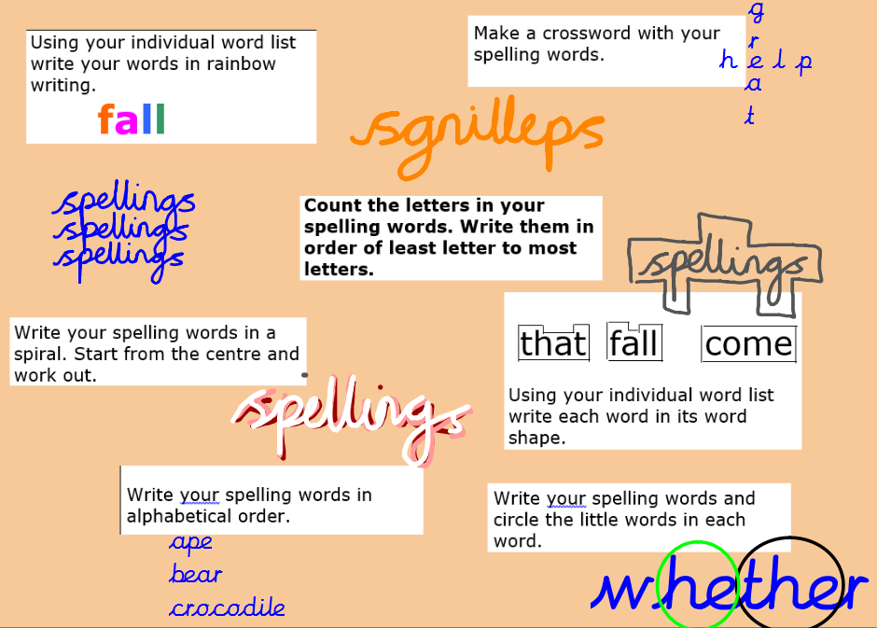
Notes:
Sam

Slide 14

PE and Games
Full PE kit is required and named please. More information listed on website. Children should come to school in their PE kit when they have a PE lesson – NOT when they have a club.
Swimming at Sevenoaks Leisure Centre to start at the end of April.
Notes:
Georgette

Slide 15
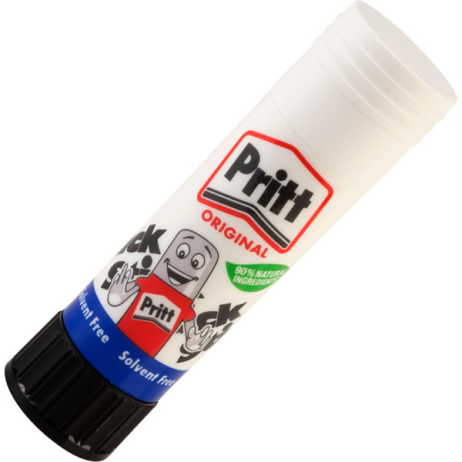
Stationery Reminders
Spare glue sticks
Spare glue sticks
Spare glue sticks
We do provide the stationery
your child needs, please don’t
send them in with 17 massive pencil cases!
Notes:
Sam H-R

Slide 16
Whole School Focus
‘Inspire Every Pupil’
Build teamwork, caring ethos, communication, respect within classes
Continuing Circle Time
Improving the learning environment-classrooms/playground
Embedding comprehension through Guided Reading
Reinforce school values and behaviour curriculum
Explicitly teaching and modelling behaviours we wish to see e.g. table manners, not answering back, following instructions from the adults, appropriate language, holding doors open for others, wearing correct school uniform and PE kit
Notes:
Sam H-R

Slide 17
Weekly Routines
Music lessons
  Children should only have one lesson during curriculum time
  If your child is away or on a school trip, it is your responsibility to inform their music teacher
Clubs
  Your child should inform the person running the club if they are going to be absent or no longer wish to participate
  We encourage every child to attend at least one club
Parent-Teacher Communication
  For quick questions/issues, please feel free to chat to the class teacher at the gate
  Meetings should be arranged via the school office
Notes:
Sam

Slide 18
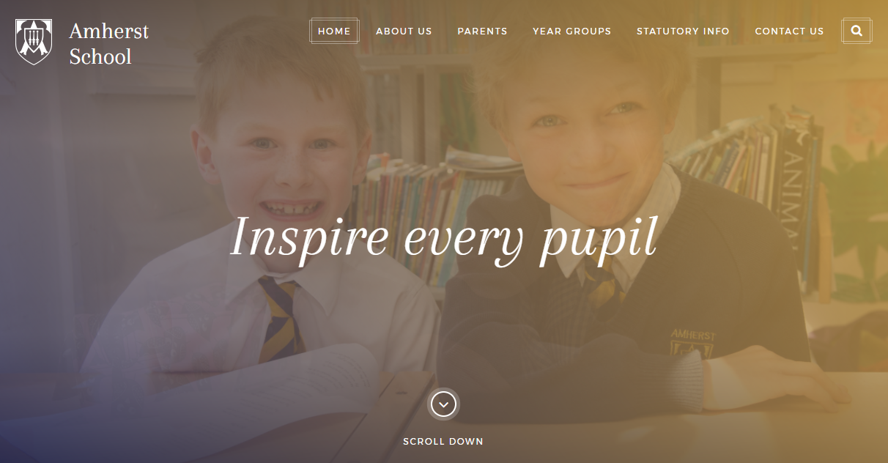
School Website
Notes:
Sam

Slide 19
Positive Routines
Encouraging independence.
Participation in the arts (e.g. dance, drama, music).
Unstructured free play.
“Cultural capital”: going to museums, libraries, dinner-time conversation about the world, etc.
Notes:
Georgette

Slide 20
After This Meeting
We’re a team!
Once we have finished in the hall, there is the opportunity to visit your child’s classroom.
If you are ready to leave even after five minutes, please don’t feel pressure to stay!
We have individual Parent Consultations in November to discuss your child’s academic progress, if there is something you want to discuss before then, please book in a meeting with the office.
Notes:
Sam

Slide 21
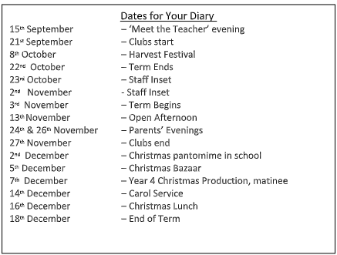
Dates for the Diary
Maths parent workshops
Friday October 2nd - Formal written methods
Thursday19th November - Times table workshop
Notes:
Sam

