Slide 1

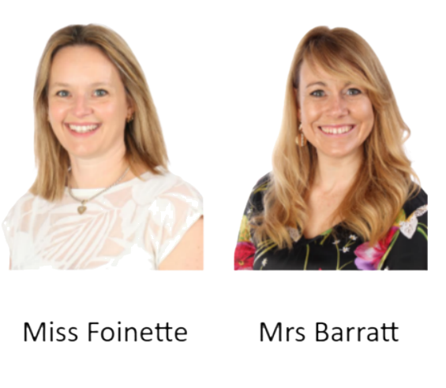
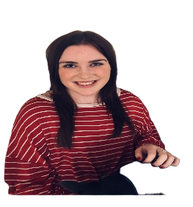
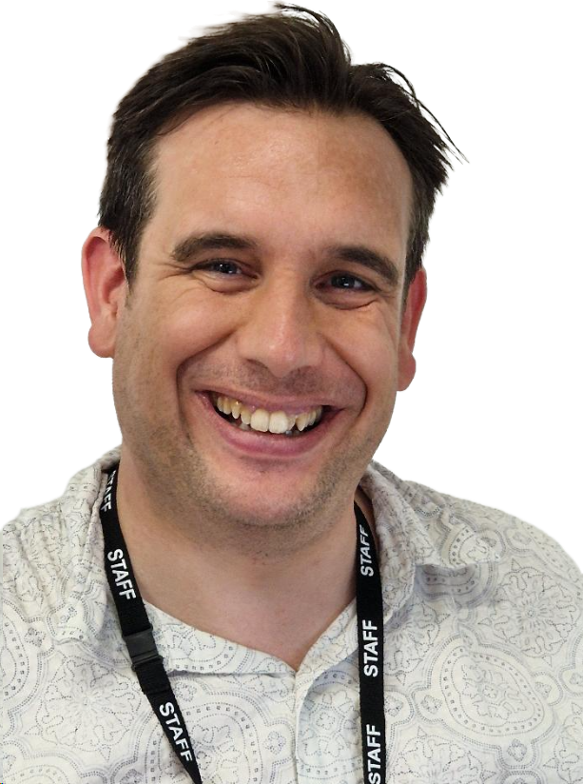



WELCOME TO YEAR 3
Oak: Miss Foinette & Mrs Barratt- Year Group Leaders
Ash: Mrs Kelly
Elm: Mr Stevens

Slide 2
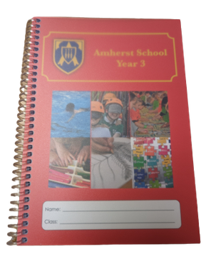
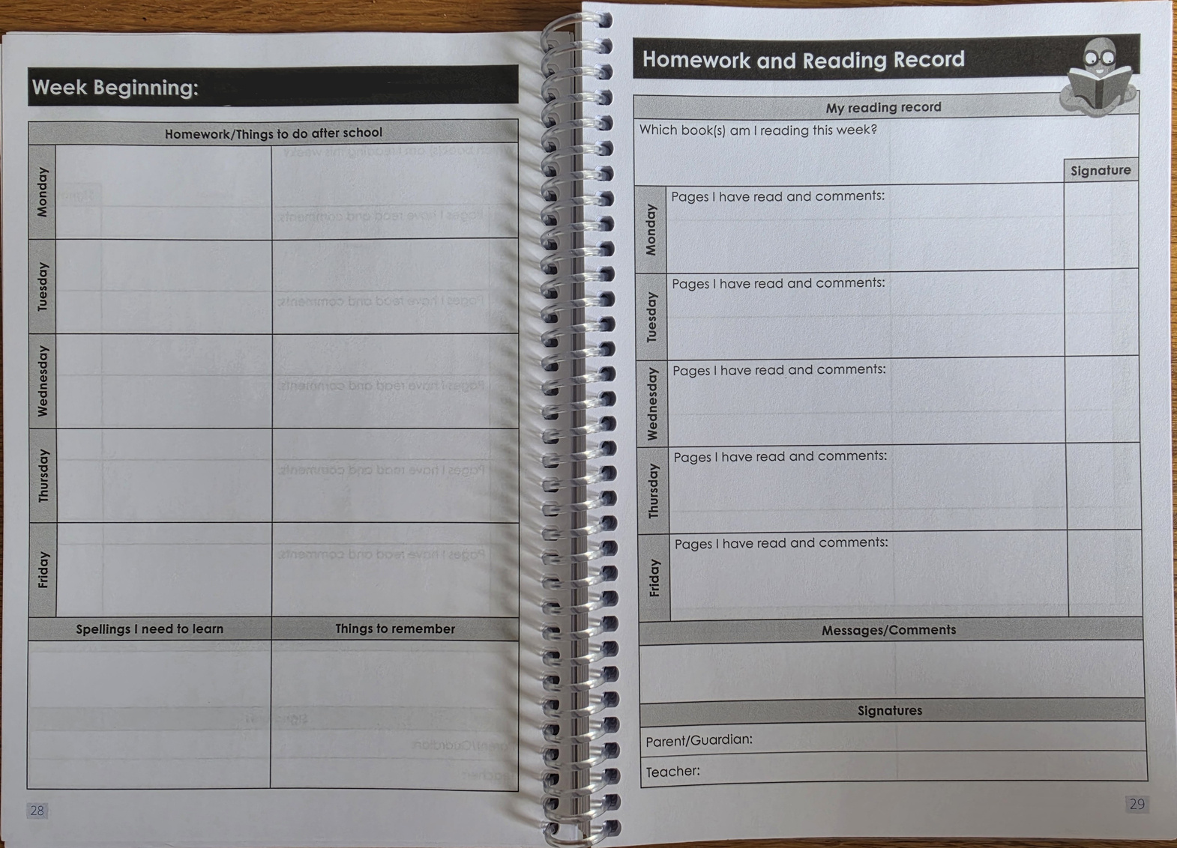
PLANNERS
Hand in on Fridays. Have in school every day.
Record reading (children or adults)
Any other messages between home and school
Please sign every week

Slide 3

HOMEWORK
Set on a Friday. Hand in by Wednesday.
1. MA Books
2. Spellings
3. Reading
4. Times Tables

Slide 4
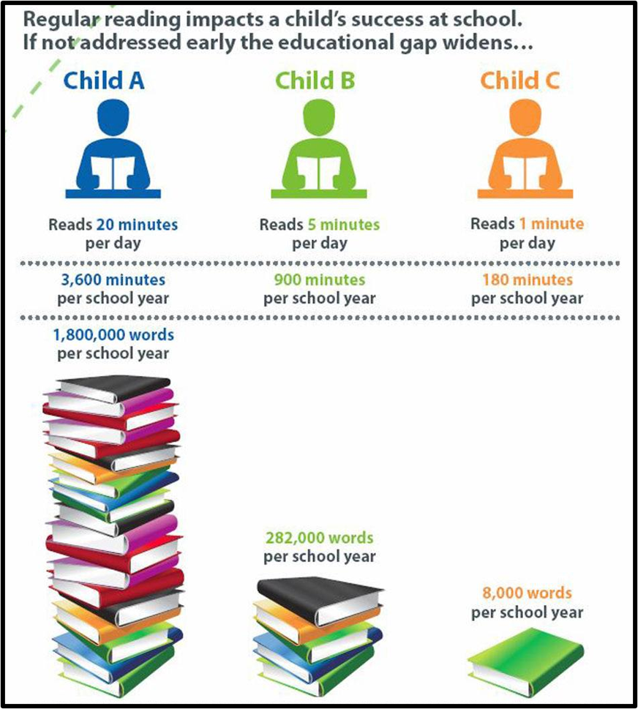
DAILY READING
  Mixture of reading aloud, independently & listening to an adult or audiobook.
  Monitor child’s comprehension by discussing what they are reading.
  Record reading in planners.

Slide 5


Slide 6

VOLUNTEER PARENT READERS
Please indicate on www.schoolgateway.com if you or any grandparent are interested in reading with our children.
Year 3 readers are needed on a Monday afternoon.

Slide 7

SPELLING HOMEWORK
•Spelling words set each week and are stuck into the front of the orange spelling book on Fridays.
•20 minutes practicing spelling words ready for test on Wednesday (OAK & ASH) or Thursday (ELM).
•Words will be a mixture of spelling rules from lessons, common exception words and statutory word lists.
•Initially, there will be a choice of which spellings to learn/ Challenge words are optional.

Slide 8
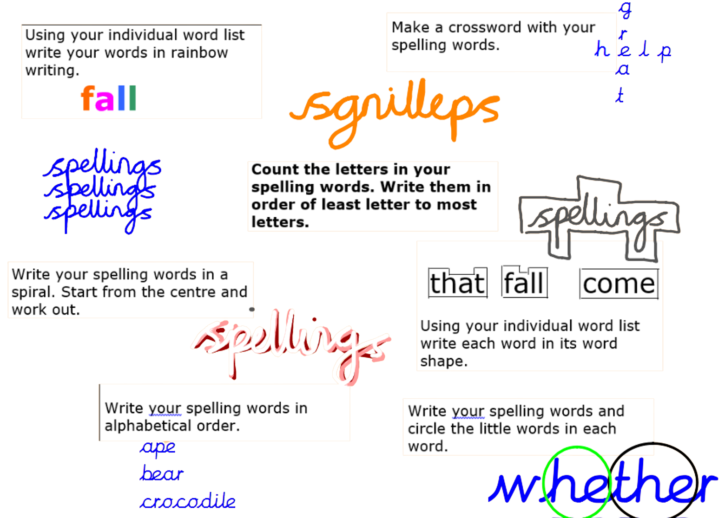
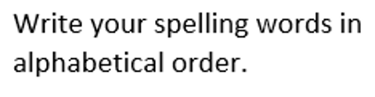
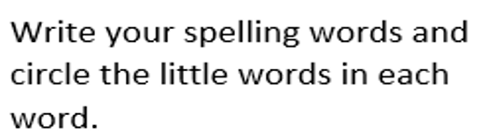

Slide 9

M.A.
(Mental Arithemetic)
  Approximately 30 minutes.
  Please complete corrections from previous week.
  Children will require more support to begin with, particularly with vocabulary. Please * any questions which have required a lot of support.
  We regularly review the book your child is on and move them if needed.

Slide 10

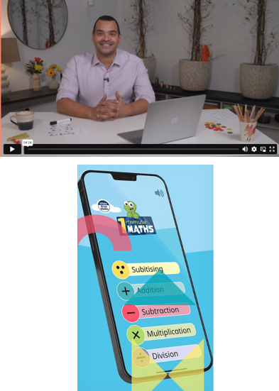
How can I help my child with maths?
  At Amherst, we follow the White Rose Maths scheme.
  Maths with Michael: Video resources for parents explaining teaching methods.
  1 minute maths: App for improving number confidence and fluency.
  Times Tables Rockstars
  Ask! We are happy to go through any MA questions with children at school.
  Maths Workshop for Parents Friday October 2nd Formal written methods, Thursday 19th November Times table workshop

Slide 11
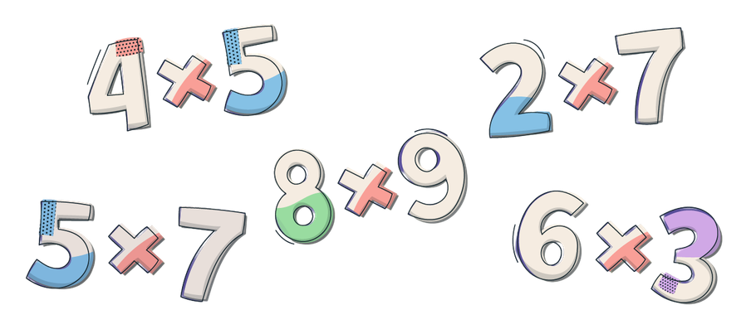
TIMES TABLES
  Weekly differentiated times tables tests
  Teachers reassess appropriate level throughout the year
  Children encouraged to ‘compete’ against themselves
  Please practise times tables at home.
  Begin with 2, 5 and 10s. Then 3, 4 and 8s.
  Lots of good apps for practising, songs, games etc. – little and often!

Slide 12


LEXIA & TTRS
  Log-in details at the back of your child’s planner
  These are suggestions of apps that might help your child

Slide 13
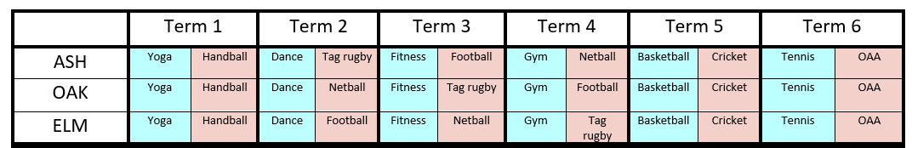
P.E. & GAMES
PE day will change throughout the year.
Elm & Ash will need Football Boots after half term.
Please make use of the ‘Boot Swop Box’ in Reception.
(Bring a pair to swop or pay £2.)

Slide 14

WHOLE SCHOOL FOCUS
  Embedding reading comprehension skills
  Continuing Circle Time
  Build teamwork, ethos, communication, respect within classes
  Reinforce school values and behaviour curriculum
  Explicitly teaching and modelling behaviours we wish to see e.g. table manners, not answering back, following instructions from the adults, appropriate language (not discriminatory), holding doors open for others
  Wearing correct school uniform

Slide 15
WEEKLY ROUTINES
MUSIC LESSONS
  Children should only have one lesson during curriculum time
  If your child is away or on a school trip, it is your responsibility to inform their music teacher.
CLUBS
  Your child should inform the person running the club if they are going to be absent or no longer wish to participate
  We encourage every child to attend at least one club
PARENT-TEACHER COMMUNICATION
  For quick questions/issues, please feel free to chat to the class teacher at the gate
  Meetings should be arranged via the school office

Slide 16
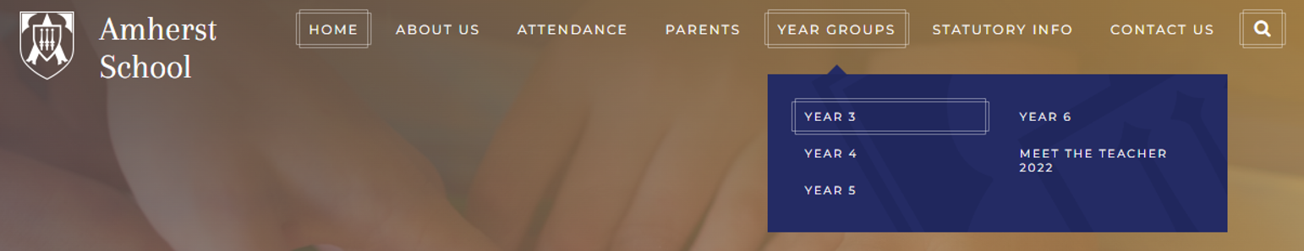
OTHER INFORMATION
  School Newsletter: If you read anything each week, please read this!
  School Website: Curriculum overview, Menus, Absence etc.
  Intended learning & other key messages: Sent out as an email every Friday-please read and share with your child!

Slide 17
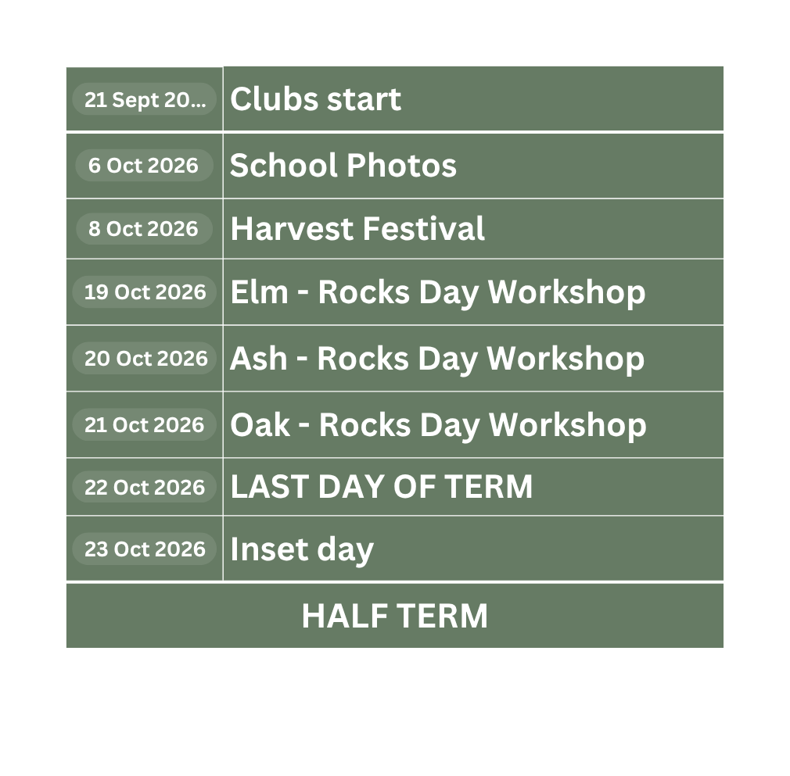
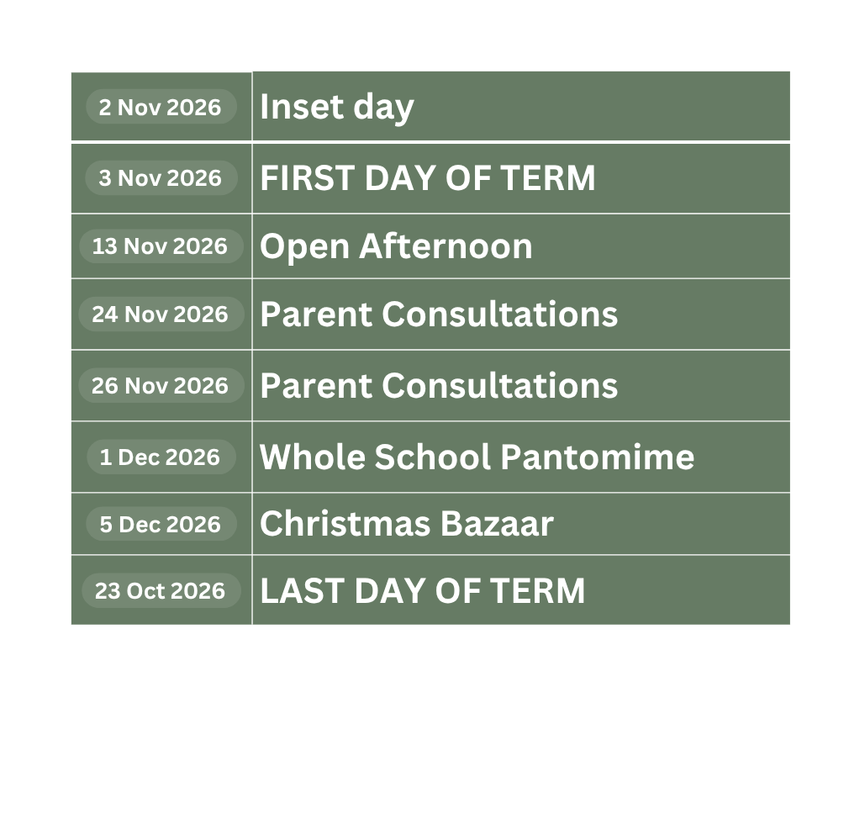
DIARY DATES
All on weekly newsletter

Slide 18
AFTER THIS MEETING
  You can visit your child’s classroom and meet their teacher.
  Leave whenever you are ready, there is no pressure to stay!
  Parents’ Evening in November 24th and 26th. (Oak not 24th but 25th)
  If you would like a meeting with your child’s teacher before November, please contact them via the office.

