Slide 1
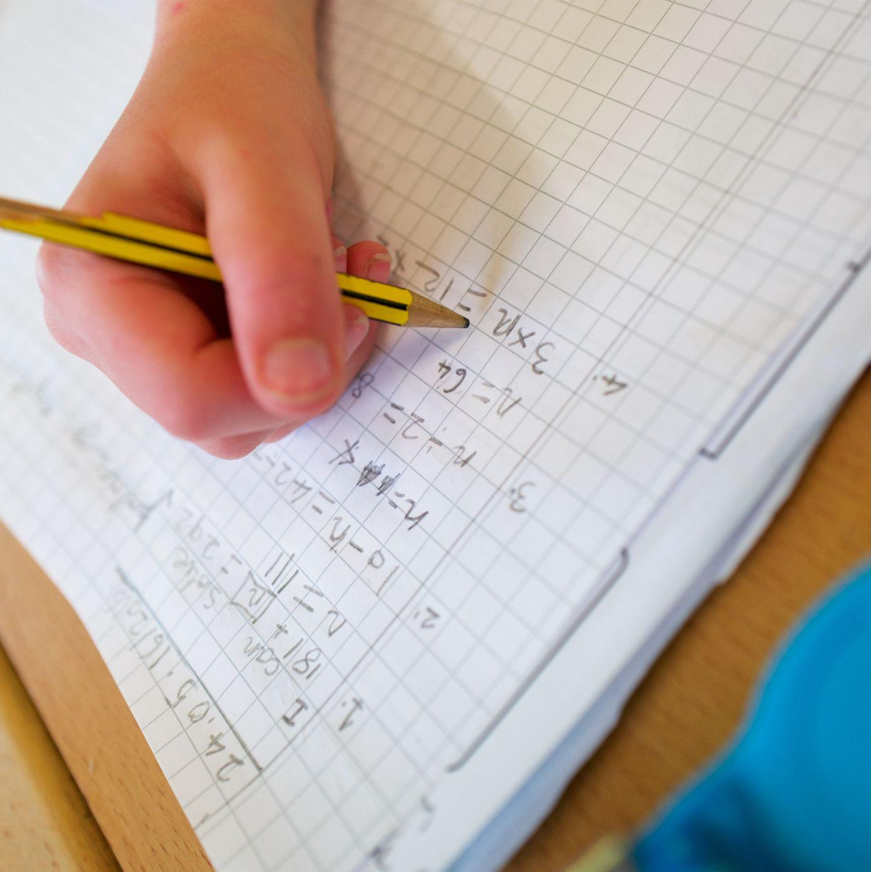
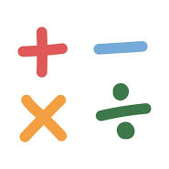
Calculations at Amherst
Thank you for coming
Notes:
TJ

Slide 2

How would you solve these?
345x7
99x5
Notes:
Whilst both are multiplications one would use a formal method- pen and paper written method and one would use a mental method
This was not to scare you but to get you to think about maths TJ

Slide 3
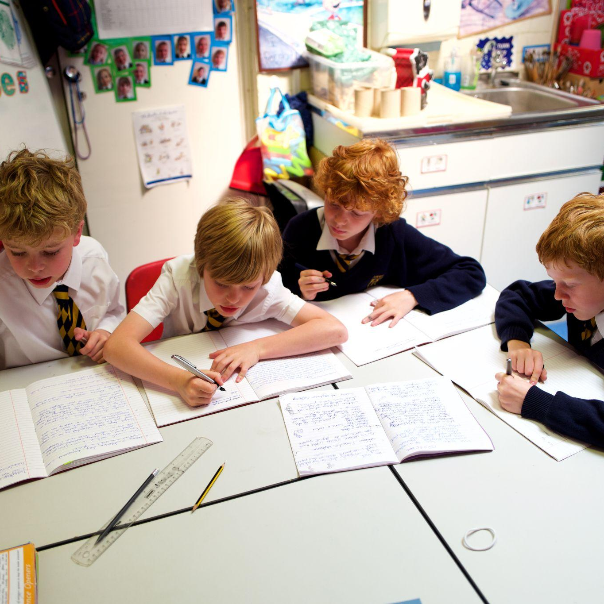
The Formal written methods
Column Addition
Column Subtraction
Multiplication
Short multiplication
Long multiplication (Yr5)
Division
-Short division
-Long division (Year 6)
Notes:
These are the 4 different operations Some taught in Year 3 and 4 and some taught further up the school. JB

Slide 4
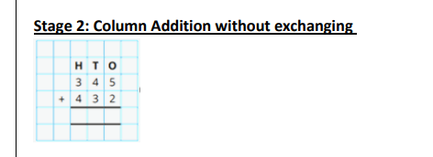
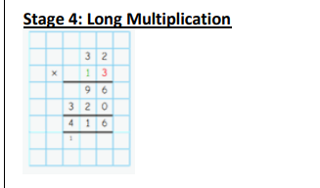
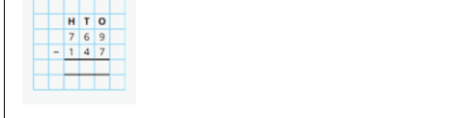
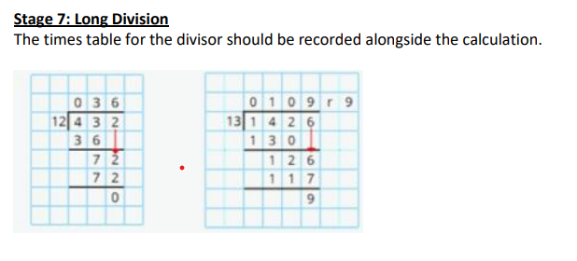
School calculation policy
https://www.amherst.kent.sch.uk/attachments/download.asp?file=4464&type=pdf
Notes:
These are extracts taken from our school policy that can be found on the school website. It shows all the building blocks using manipulatives before we teach the children the formal methods. It would be good to familiarise yourself with these methods. JB

Slide 5


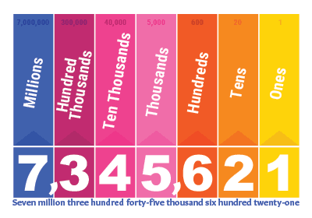
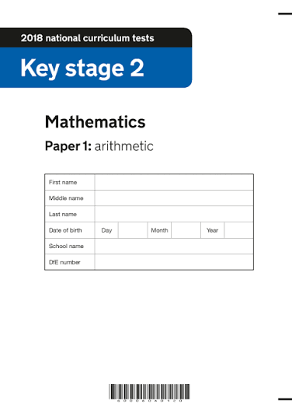
Why do we teach the methods?
solve calculations with larger numbers
.
Reliable and efficient
Reinforces place value
Arithmetic Paper in KS2 SATS
Notes:
TJ

Slide 6
Before children do a calculation they should ask themselves
• Can I do this in my head using a mental strategy?
• What is the approximate answer? (estimation)
• Could I do jottings to keep track of the calculation?
• Can I use a picture or manipulatives to help me understand?
• Do I need to use a written method to solve the calculation?
• How can I check my answer is reasonable?
Notes:
JB

Slide 7
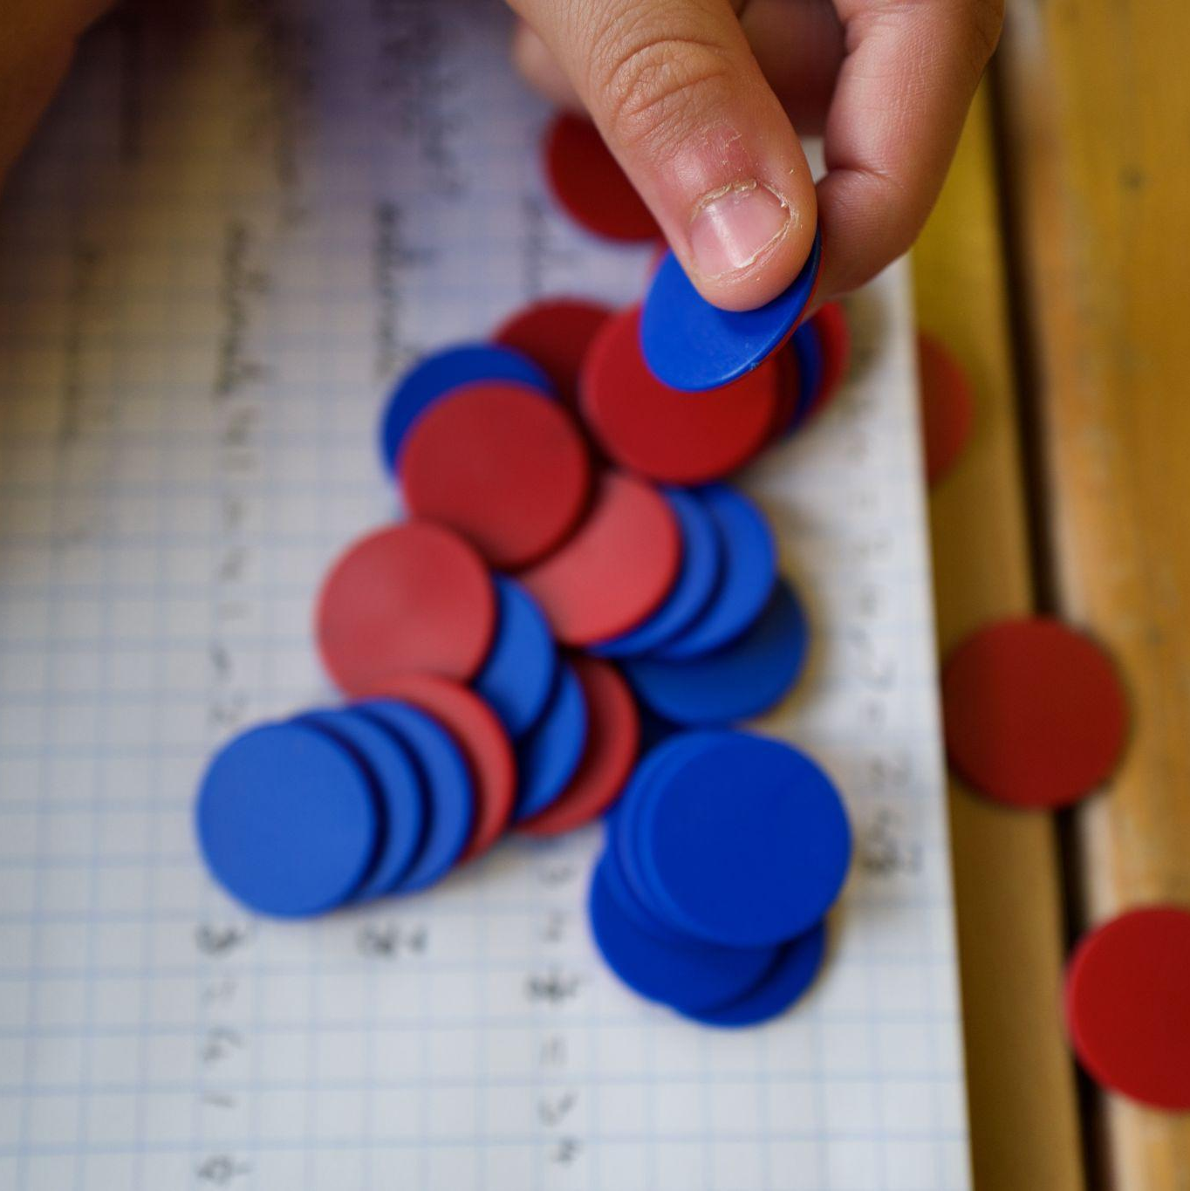
How we teach the written methods.
Using manipulatives (equipment) so pupils understand the maths behind the method when it is first introduced.
Using the word exchanging rather than borrowing
Using the terminology ones not using units
Encouraging flexibility to help support pupils in choosing the most efficient method to solve a calculation
Notes:
JB

Slide 8
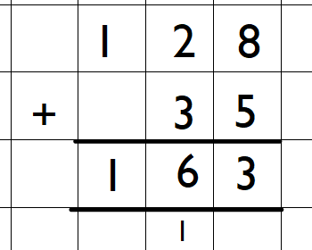
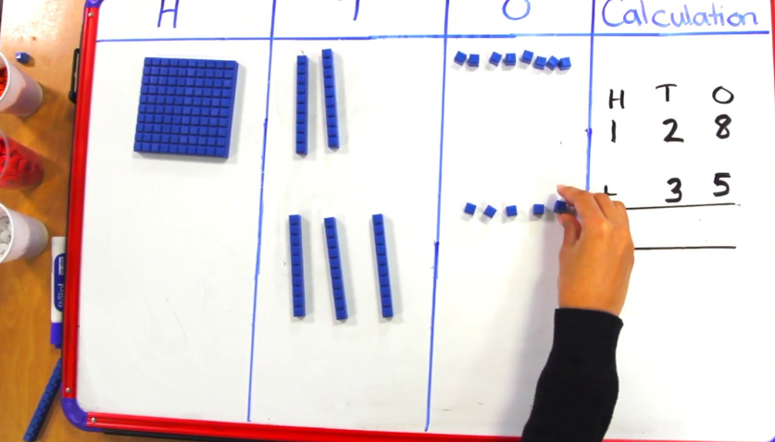
Column addition
Notes:
Jb place value chart

Slide 9
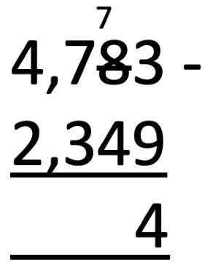
Column subtraction
Subtraction
Notes:
TJ

Slide 10
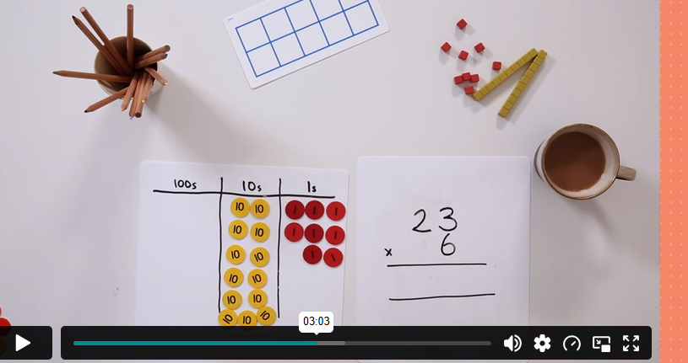
Short multiplication
Multiplication
Long multiplication in Year 6
Notes:
TJ

Slide 11
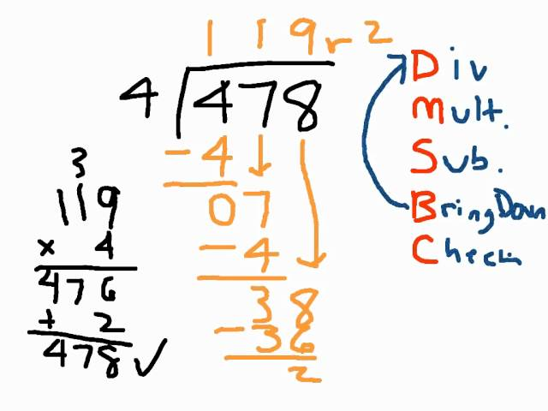
Short division
Division
Notes:
JB

Slide 12
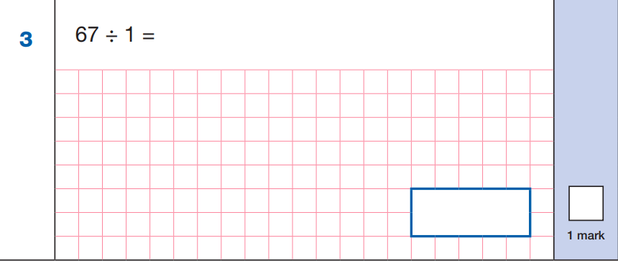
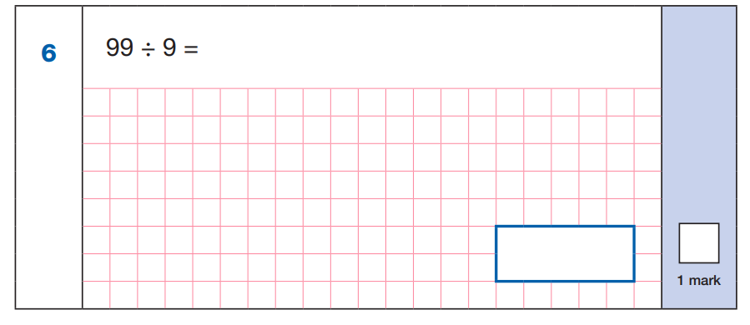
Promote flexibility
Two examples of KS2 SATS questions from the Y6 arithmetic paper this year. Lots of children chose to answer using written methods yet this lead to errors rather than being an efficient calculator choice in this instance.
Many children solved this using short division
This could be solved using times table facts/ noticing patterns
Notes:
JB

Slide 13
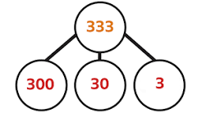
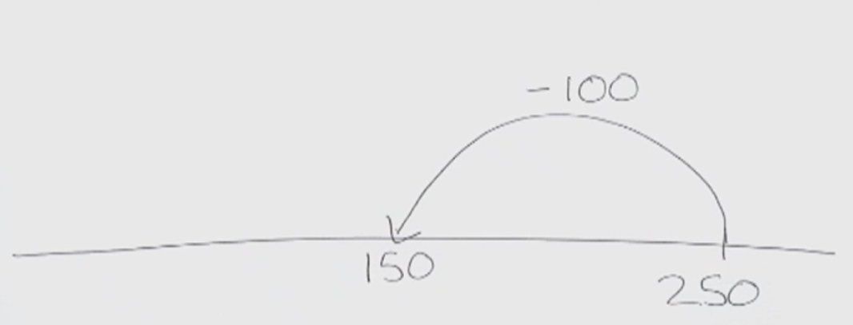
Other techniques taught in school
Drawing a blank number line
Using number bonds and times tables and multiples of 10.
If I know 5 + 13 I know 50 +130
Partitioning a number
Using their fingers
Informal jottings
Notes:
TJ

Slide 14
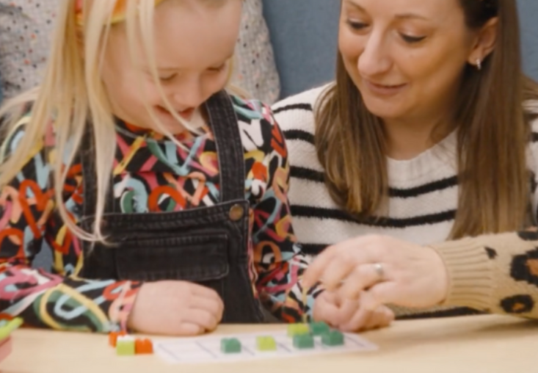
How parents can help
Promoting flexibility in calculations. Asking your child what do you think is the best method for this
Using language taught in school wherever possible (exchangine, ones)
Promoting accurate setting out with columns set out clearly
Discussing the value of digits (Is it 2 or 20?)
Ask for help with MA if needed at school if your child is trying to use a different method to what you expect
Trying to make real life links to maths wherever possible.
Promote a love of maths and being aware of your own possible maths worries.
Notes:
TJ

Slide 15

In the classrooms
Play a game
Enjoy working alongside your child.
Ask them to explain the game to you.
Check their calculations.
Try to beat them!
Year 3- Number bonds to 10
Year 4- Column addition
Notes:
TJ

